Slide 1
FINAL PROJECT · VIBE CODING CEDIA 2026
Registro Vivo · Living Literature Register
Up-to-date literature reviews, free of duplicates, with every decision recorded
Diana Cevallos (UTE) · Monica Calva (UTPL)
Master's in Educational Administration · Computer Science and Electronics · Project guide 10
Narration generated with an AI voice (ElevenLabs) and reviewed by the authors.
Vibe Coding CEDIA 2026 · Universidad UTE · UTPL
1 / 10
Notes:
COVER
We present Registro Vivo, a living literature register.
It keeps a literature review up to date without losing control of any decision.
It was built by Diana Cevallos from U T E and Monica Calva from U T P L.

Slide 2
FINAL PROJECT · VIBE CODING CEDIA 2026
The problem
Reviews go out of date, repeat articles and lose the reason behind each decision.
A CONCRETE EXAMPLE
One new search returned 19 articles: 4 were already in the collection.
Vibe Coding CEDIA 2026 · Universidad UTE · UTPL
2 / 10
Notes:
PART A · PRESENTATION (3 min in total)
Every research project starts with a literature review.
The problem is that this review ages quickly.
Each new search brings repeated articles that someone reads again.
Decisions get lost between folders and emails.
Months later nobody remembers why a study was included or excluded.
This happens to any instructor who does research.
In our case a single search returned nineteen articles.
Four of them were already in the collection.
Without control we would have read them twice.
This wastes time and weakens the evidence.

Slide 3
FINAL PROJECT · VIBE CODING CEDIA 2026
The tool
WHO USES IT
WHAT GOES IN
WHAT COMES OUT
Instructors who do research
Batches exported from academic databases (CSV)
Duplicate-free collection, decision log and PRISMA diagram
Vibe Coding CEDIA 2026 · Universidad UTE · UTPL
3 / 10
Notes:
THE TOOL · NARRATION · ≈30 s · 70–80 words
Registro Vivo is designed for instructors who do research.
It receives the batches that a person exports from academic databases such as Scielo.
It delivers three products.
The first is a clean collection without duplicates.
The second is a log of every decision with its reason and its date.
The third is the Prisma flow diagram with a version history.
The tool is based on project guide number ten of the course.

Slide 4
FINAL PROJECT · VIBE CODING CEDIA 2026
How it works
1 · INPUT
2 · AI
3 · REVIEW
4 · RESULT
Searches and exports, unchanged
Detects duplicates, suggests priority
Reads the abstract and decides
GitHub records every change
Including or excluding a study is always a human decision.
Vibe Coding CEDIA 2026 · Universidad UTE · UTPL
4 / 10
Notes:
HOW IT WORKS · NARRATION · ≈40 s · 95–105 words
The workflow has four steps.
First the person searches the database and exports the results without changing them.
Next the A I normalizes the identifiers and detects duplicates.
It also suggests a reading priority based on the criteria of the protocol.
It flags each record as likely, doubtful or low relevance.
Then the person reads each abstract and decides whether the study is included.
That decision is never made by the A I.
Finally Git Hub saves every change with its author and its date.
This way nothing is lost and every step can be checked later.

Slide 5
FINAL PROJECT · VIBE CODING CEDIA 2026
Evidence that it works
4/4
20/21
15/15
duplicates detected and confirmed
“likely” records included by the reviewer
“low relevance” records excluded
AI suggestions compared with the reviewer's decisions on 62 SciELO records. A single review.
Vibe Coding CEDIA 2026 · Universidad UTE · UTPL
5 / 10
Notes:
EVIDENCE · NARRATION · ≈35 s · 80–90 words
We tested it with our own review on soft skills.
We processed sixty six records from six searches in Scielo.
The tool detected four duplicates and all four were confirmed.
Of twenty one records that the A I marked as likely the reviewer included twenty.
Of fifteen records marked as low relevance she excluded all fifteen.
The twenty six doubtful records were split between inclusions and exclusions.
That is why the final decision is human.
This is a single review and we have not yet tested it with other teams.

Slide 6
FINAL PROJECT · VIBE CODING CEDIA 2026
Limits and responsible use
WHAT IT DOES NOT DO
DATA AND PRIVACY
NEXT STEP
SciELO only; does not replace reading the abstract
Published references only; private repository
Version 1.3: ERIC, Redalyc, full text and a second reviewer
Vibe Coding CEDIA 2026 · Universidad UTE · UTPL
6 / 10
Notes:
LIMITS AND RESPONSIBLE USE · NARRATION · ≈25 s · 55–65 words
For now Registro Vivo only processes Scielo.
Its suggestions are based on the title and do not replace reading the abstract.
It does not handle personal data and the review repository is private.
Version one point three will add Eric and Redalyc and full text reading.
A second reviewer from the team will check a sample of the decisions.

Slide 7
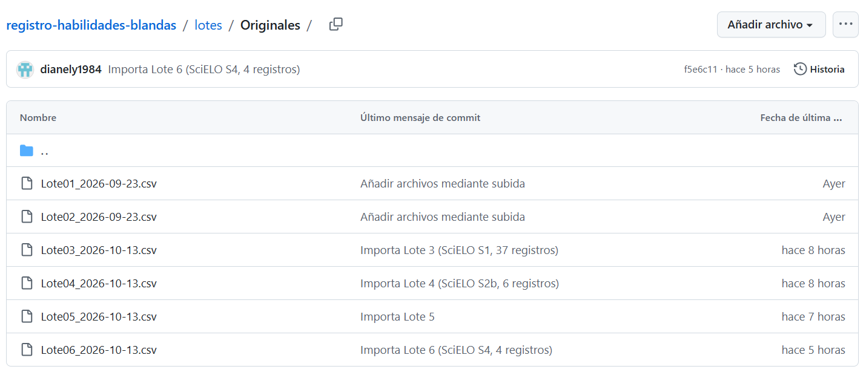
FINAL PROJECT · VIBE CODING CEDIA 2026
Demo · Input
Original batches in GitHub: each search with its date, unchanged (interface in Spanish)
Vibe Coding CEDIA 2026 · Universidad UTE · UTPL
7 / 10
Notes:
PART B · DEMO (2 min in total)
Let us look at the tool on screen.
This is the folder of original batches in Git Hub.
Each search is saved exactly as it came from the database.
The file name includes the date.
These files are never edited.
That way anyone can trace where each record came from.
The message next to each file shows the source search and its number of records.
The interface appears in Spanish because that is how we work.

Slide 8
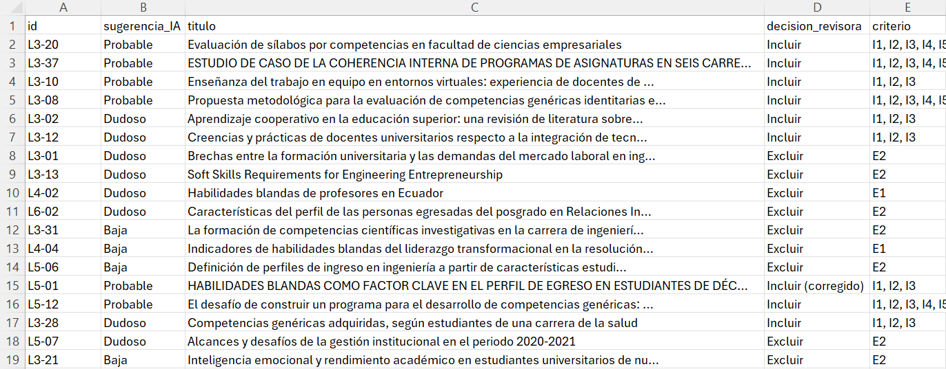
FINAL PROJECT · VIBE CODING CEDIA 2026
Demo · Result
Screening sheet: AI suggestion versus the reviewer's decision (in Spanish)
Vibe Coding CEDIA 2026 · Universidad UTE · UTPL
8 / 10
Notes:
NARRATION · ≈35 s · 80–90 words in English
The screening sheet is the central result.
In each row the A I leaves a relevance suggestion.
The reviewer reads the abstract and writes her decision with the criterion applied.
Look at the column of suggestions and the column of decisions.
Here you can see where they agree.
You can also see where they do not agree.
One study was excluded by mistake and corrected later.
The correction was recorded in the same sheet with its criterion.
Nothing is overwritten without a trace.

Slide 9
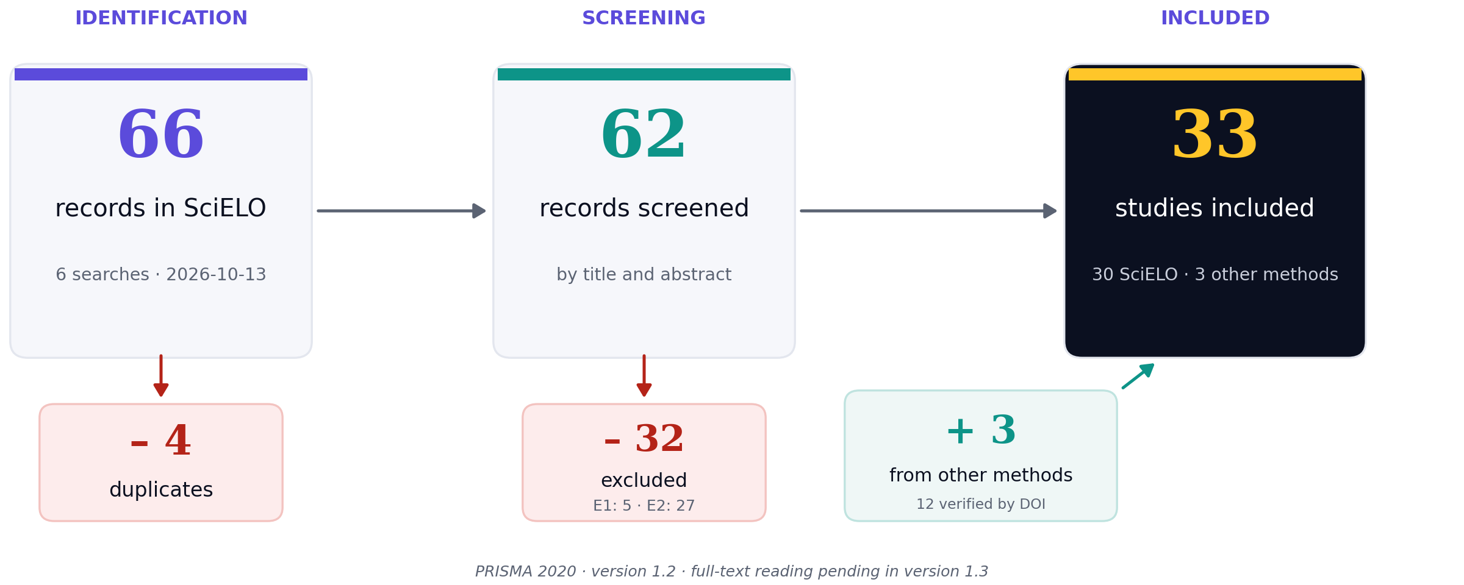
FINAL PROJECT · VIBE CODING CEDIA 2026
Demo · Review and delivery
PRISMA flow for version 1.2: 33 studies included
Vibe Coding CEDIA 2026 · Universidad UTE · UTPL
9 / 10
Notes:
NARRATION · ≈30 s · 70–80 words in English
In the end everything is summarized in the Prisma flow diagram.
It shows how many records were identified and how many were removed at each stage.
We started with sixty six records from Scielo.
The tool removed four duplicates and sixty two records went to screening.
During screening the reviewer excluded thirty two by title and abstract.
Three studies found through other methods were added.
That gives thirty three included studies.
It also shows the reasons for exclusion.
Each version of the collection is published with a tag in Git Hub.
The person decides when a version is ready.
Version one point two matches what you have just seen.
We used this diagram to write the methods section of our article.

Slide 10
FINAL PROJECT · VIBE CODING CEDIA 2026
Every decision, with its reason and date
Next step: version 1.3. Adapt it to your own research.
dianely1984.github.io/vibe-coding-proyecto-final
Diana Cevallos (UTE) · Monica Calva (UTPL)
Vibe Coding CEDIA 2026 · Universidad UTE · UTPL
10 / 10
Notes:
CLOSE · NARRATION · ≈25 s · 55–65 words
Registro Vivo changes the way we review the literature.
Decisions are no longer lost between folders.
Every study keeps its reason and its date.
Monica Calva guided the analysis of the teaching plans at U T P L.
Our next step is version one point three.
We invite you to adapt Registro Vivo to your own research.
Thank you for your attention.

